Slide 1






2.1 High level component and their interactions
Server
Client
Firewall
Firewall
Network
Mobile Interface
Database Server
Travlendar+ DB
Application Logic

Slide 2
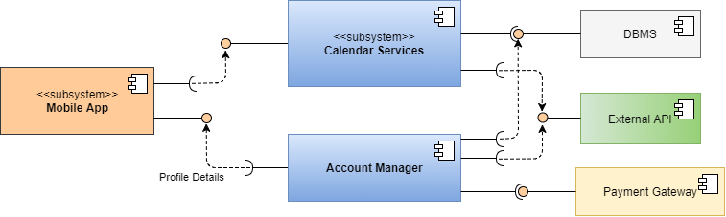
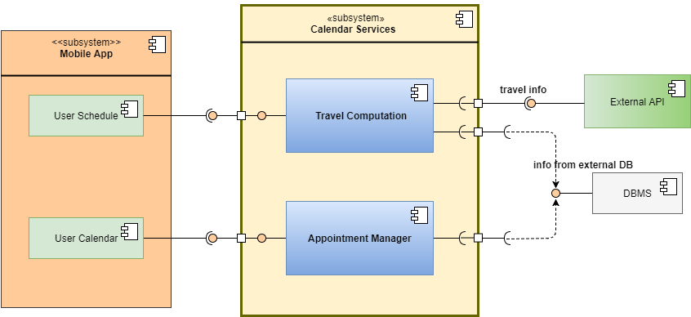
2.2 Component view
Interaction among architectural component
is so defined:
The subsystem ‘Calendare Services’ requires
the interface from DBMS, which provides
information stored inside travlendar+ database
or external database, and the interface of external API,
which provides travel information to compute
Best travel for user. Instead it provides
interface for the user app.
The ‘Payment Manager’ require the interface of
A payment gateway, which permits to execute
Payments, and requires the interface of
user account to take information
About account details

Slide 3

2.2 Deployment view
<<device>>
Mobile Smartphone
<<device>>
Database Server
Mobile Interface
<<device>>
Firewall
Oracle MySQL Database
Application
Logic
JDBC
JDBC
External Database

Slide 4



2.6 Architectural styles and patterns
Architectural style:
3-tier Client-Server
Data
Client
Server
Database
Server
Dbms
Mobile Interface
Network
Application
Server
Travlendar+ DB

Slide 5
2.6 Architectural styles and patterns
Patterns:
State pattern
Visitor pattern

